Slide 1
SMART PARKING

Slide 2
Smart parking documentation and objectives
Smart parking is an innovative approach to managing and optimizing parking spaces in urban and suburban areas. It involves the use of technology and data-driven solutions to improve the efficiency, convenience, and overall management of parking facilities. The key components of smart parking systems include sensors, data analytics, real-time information, and digital tools to help drivers find available parking spaces quickly.
Problems Addressed by Smart Parking
Traffic Congestion
Inefficient Space Utilization

Slide 3
Specifications
Hardware:
Arduino Board
IR Sensors (IR1 and IR2)
Liquid Crystal Display (LCD)
Servo Motor
Smoke Detector
Buzzer
Ultrasonic sensor
Software:
Arduino IDE
Programming language : c++

Slide 4
CIRCUIT DIAGRAM AND EXPLANATION
IR (Infrared) sensors are commonly used in smart parking systems to detect the presence or absence of vehicles in parking spaces. These sensors work based on the reflection or interruption of an infrared beam and are widely utilized in various applications, including smart parking. Here’s how IR sensors are used in smart parking systems
Presence Detection: IR sensors emit an infrared beam, which, when not interrupted by a vehicle, is received by a photodetector (receiver). When a vehicle enters the parking space, it blocks the infrared beam, causing the receiver to detect the interruption and trigger an event, indicating the presence of a vehicle.

Slide 5
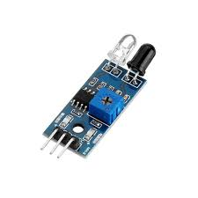
IR sensors are often installed at the entrance or exit of each parking space to monitor occupancy. They can be positioned at a height where the infrared beam is not easily blocked by obstacles other than vehicles. When a vehicle enters a parking space, the interruption of the IR beam is detected, and this information is used to update the status of the parking space (occupied) in the smart parking system

Slide 6
Working and explanation
The Internet of Things (IoT) is a technology concept that refers to the interconnection of everyday physical objects or “things” to the internet, allowing them to collect and exchange data. IoT has the potential to transform various aspects of our lives by making objects smarter and more capable. Here are some key aspects of IoT
Smart parking systems using IoT (Internet of Things) technology aim to address the challenges associated with parking in urban areas by employing a variety of sensors, communication technologies, and data analysis. These systems improve parking efficiency, reduce congestion, and enhance the overall parking experience. Here’s an overview of how smart parking using IoT works

Slide 7
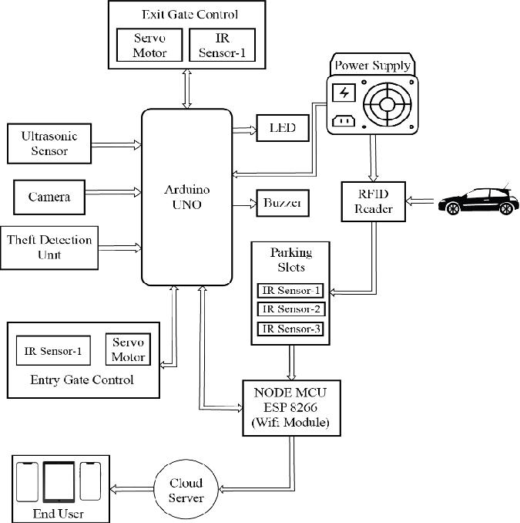
Block diagram

Slide 8
Coding
#include <Wire.h> #include <LiquidCrystal_I2C.h> LiquidCrystal_I2C lcd(0x27, 16, 2); // Change the HEX address #include <Servo.h> Servo myservo1; int IR1 = 2; int IR2 = 4; int SmokeDetectorPin = 6; // Digital pin for the smoke detector int BuzzerPin = 7; // Digital pin for the buzzer int Slot = 4; // Enter Total number of parking Slots bool flag1 = false; bool flag2 = false;

Slide 9
Unsigned long lastLcdUpdate = 0; // Variable to track the time of the last LCD update unsigned long lcdUpdateInterval = 1000; // Update the LCD every 1000 milliseconds (1 second) void setup() { lcd.begin(16, 2); // Initialize LCD with 16 columns and 2 rows lcd.backlight(); pinMode(IR1, INPUT); pinMode(IR2, INPUT); pinMode(SmokeDetectorPin, INPUT); pinMode(BuzzerPin, OUTPUT); myservo1.attach(3); myservo1.write(100); lcd.setCursor(0, 0);

Slide 10
Lcd.print(“ ARDUINO “); lcd.setCursor(0, 1); lcd.print(“ PARKING SYSTEM “); delay(2000); lcd.clear(); Serial.begin(9600); // Start serial communication for debugging } void loop() { if (digitalRead(IR1) == LOW && !flag1) { if (Slot > 0) { flag1 = true; if (!flag2) { myservo1.write(0); Slot--; } } else { displayMessage(“ SORRY ☹ “, “ Parking Full “);

Slide 11
} } if (digitalRead(IR2) == LOW && !flag2) { flag2 = true; if (!flag1) { myservo1.write(0); Slot++; } } if (flag1 && flag2) { delay(1000); myservo1.write(100); Serial.println(“Servo returned to initial position.”); flag1 = false; flag2 = false; }
// Update the LCD display with a delay if (millis() – lastLcdUpdate >= lcdUpdateInterval) { updateLcdDisplay(); lastLcdUpdate = millis(); } // … (Rest of your code) } void updateLcdDisplay() { if (digitalRead(SmokeDetectorPin) == HIGH) { displayMessage(“ WARNING! “, “ Smoke Detected “); digitalWrite(BuzzerPin, HIGH); // Turn on the buzzer } else { displayMessage(“ WELCOME! “, “Slot Left: “ + String(Slot)); digitalWrite(BuzzerPin, LOW); // Turn off the buzzer

Slide 12
} } void displayMessage(const char *line1, const String &line2) { lcd.clear(); lcd.setCursor(0, 0); lcd.print(line1); lcd.setCursor(0, 1); lcd.print(line2); }

Slide 13
OUTPUT
Initial LCD Display: When the Arduino is powered on, the LCD display will show an initial message
IR Sensors and Servo Motor: If a vehicle enters a parking space monitored by the IR sensor (IR1), the system will detect the vehicle and update the available parking slots. If there are available slots, it will display messages like “WELCOME!” and “Slot Left: X,” where X represents the number of available slots. If no slots are available, it will display “SORRY ☹” and “Parking Full.”

Slide 14
Smoke Detector and Buzzer: If the smoke detector senses smoke (simulated in this code), it will trigger the LCD to display “WARNING!” and “Smoke Detected.” Additionally, the buzzer will sound an alarm by going high. If there’s no smoke detected, it will display “WELCOME!” as mentioned above.
Servo Motor Control: The servo motor (myservo1) is used to simulate a parking barrier. It will move to a position (0 degrees) to simulate the barrier lowering when a vehicle enters a parking space and rising back to its initial position (100 degrees) when both vehicles leave.

Slide 15
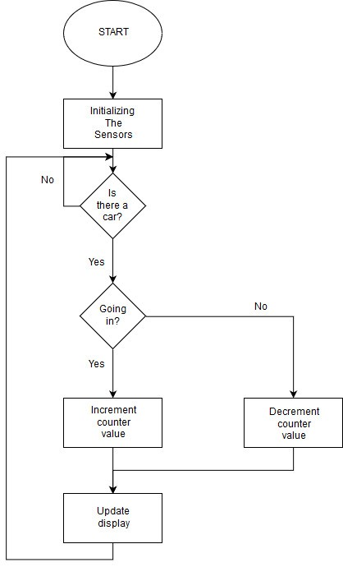
Schematic diagram

Slide 16
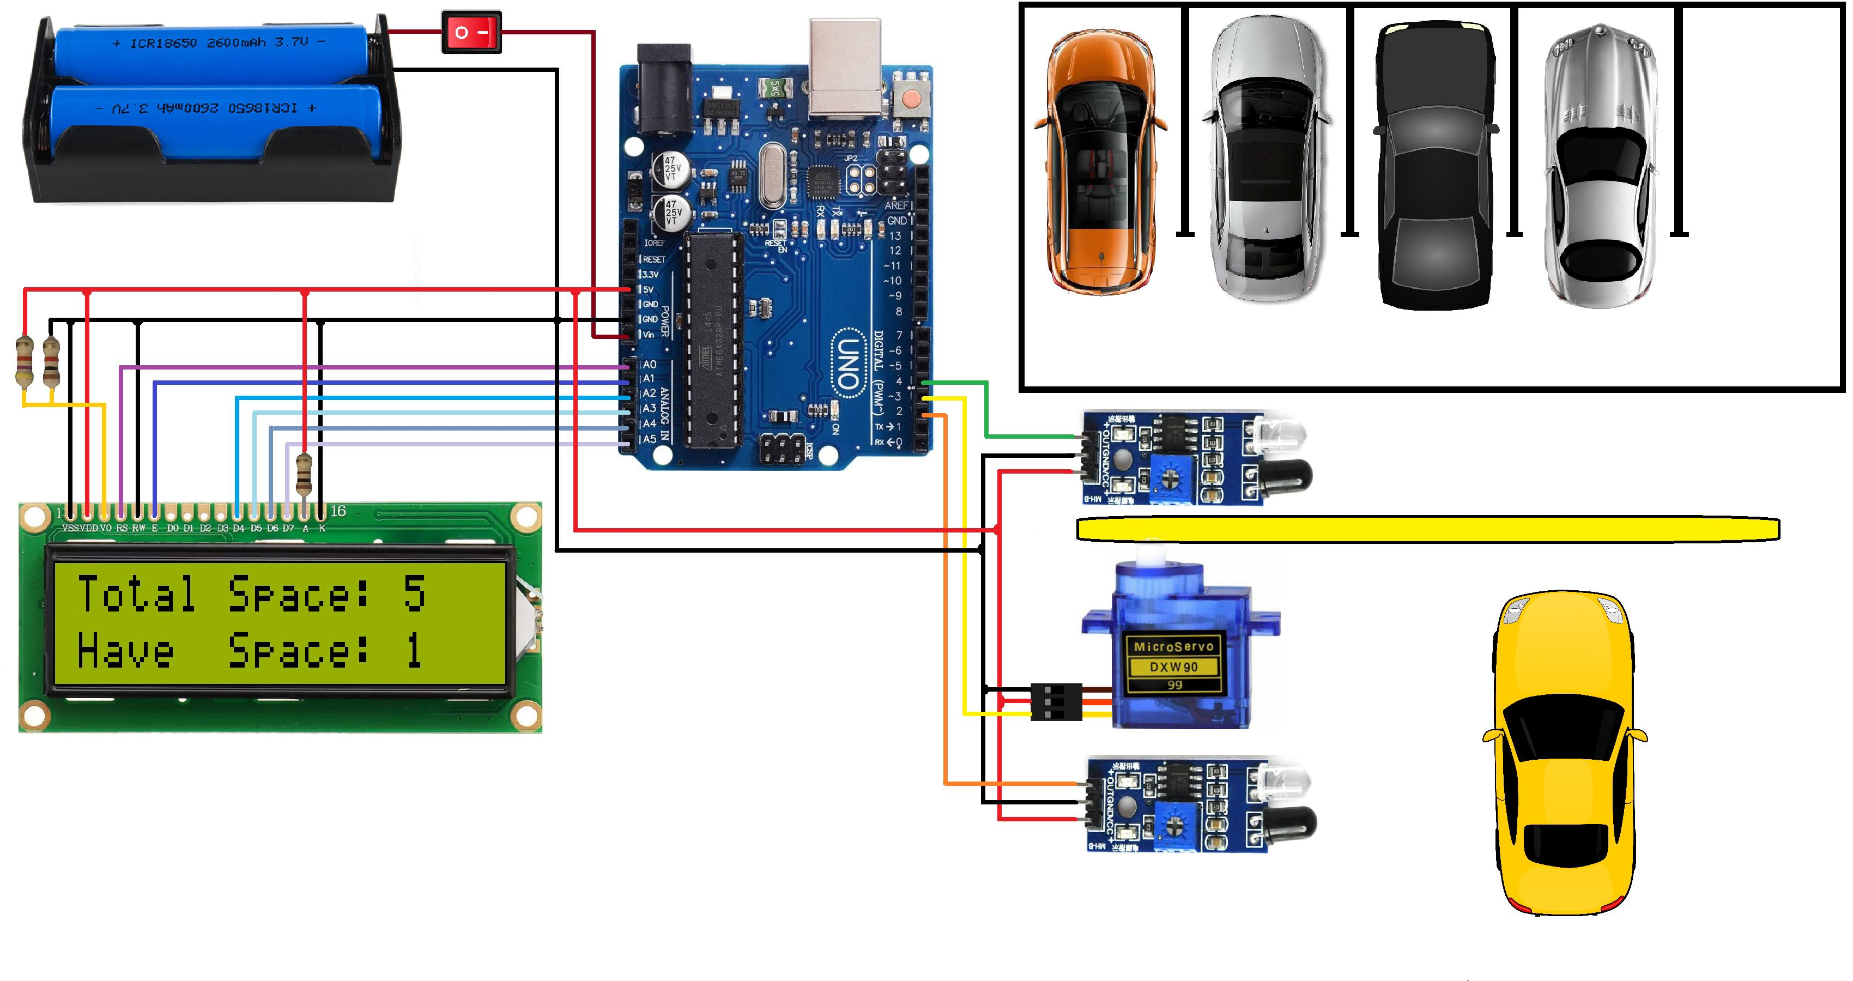

Slide 17
Application
Smart parking solutions have a wide range of applications in urban and suburban areas, offering benefits to both city authorities and residents. Here are some of the key applications of smart parking systems:
Urban Parking Management
Shopping Malls and Retail Centers
Airports and Transportation Hubs

Slide 18
Conclusion
Smart parking is a technology-driven solution that offers numerous advantages for urban and suburban areas. It addresses the challenges associated with parking in congested cities, enhances user convenience, improves traffic flow, and contributes to more sustainable and efficient urban environments. Here are some key points to summarize the benefits and significance of smart parking:

